Slide 1
Lunar Space Rover Terrain Navigation Simulation
Denis Akola, Raman Kumar Jha

Slide 2
Motivation
Relative Terrain Navigation (RTN) — is a localization technique that allows a vehicle (e.g., a rover, spacecraft, missile, or drone) to determine its position relative to known terrain features by comparing onboard sensor data with a stored terrain map or model.
Why is this relevant?
GPS-denied environments: Works where GPS is unavailable or unreliable (e.g., Mars, lunar surface, underwater, or jammed zones).
Autonomous operation: Essential for spacecraft landings (e.g., NASA’s Perseverance rover), autonomous drones, and military guidance systems.

Slide 3
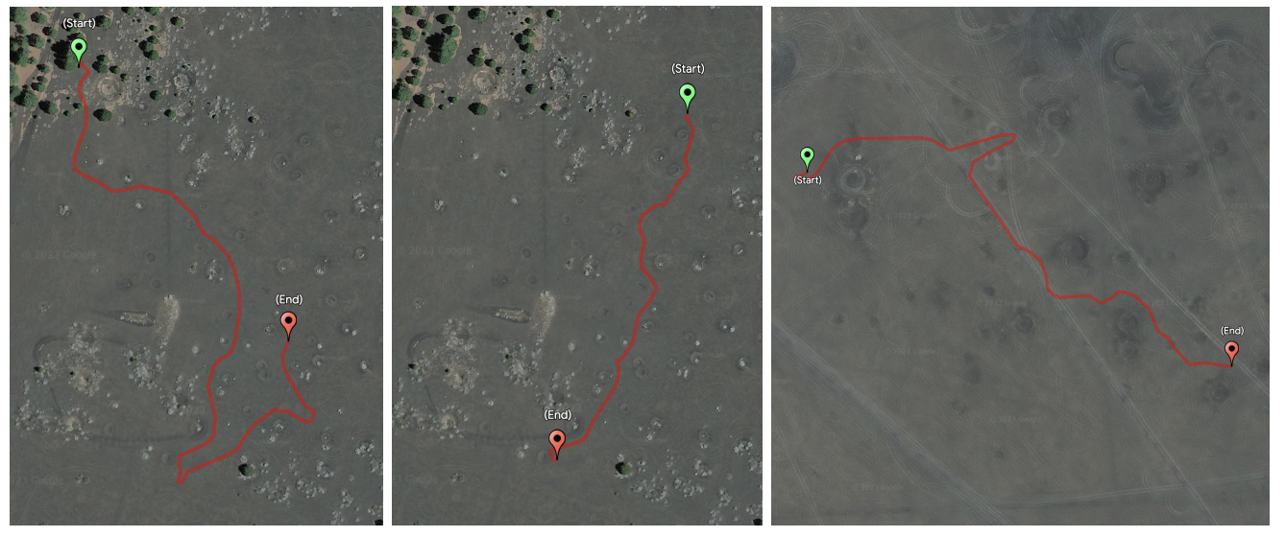
Related Work
LunarNav introduces a crater-based localization system for lunar rovers that matches locally detected craters with orbital maps to achieve global positioning without GNSS.
ShadowNav proposes a vision-based localization system that operates in permanently shadowed lunar regions by leveraging illumination-invariant features from shadow patterns.

Slide 4
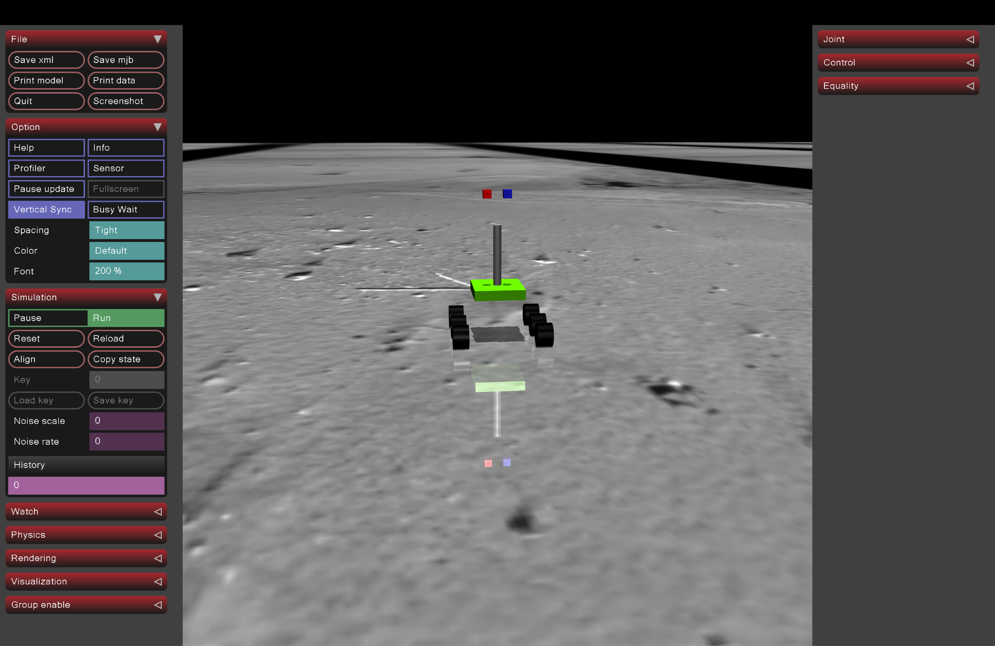
Technical Approach -Simulation
Stereo cameras for vision-based navigation

Slide 5

Results
Left Camera
Right Camera

Slide 6
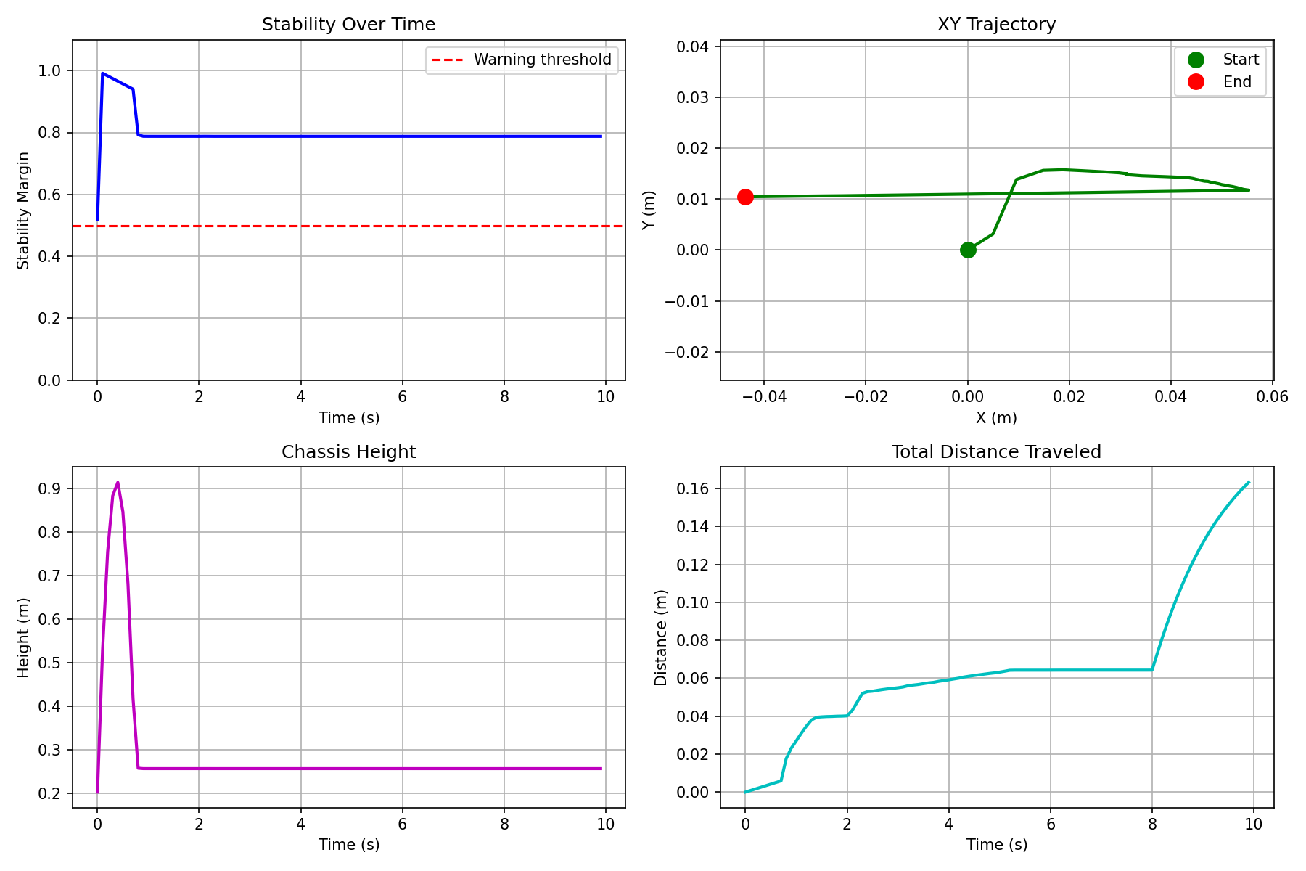
Experimental Results

Slide 7
Thank you

